Slide 1
ROBOISM ATULYA

Slide 2

Division – IOT
Topic – USAGE OF IOT IN AGRICULTURE – IOT- BASED SMART IRRIGATION
Name – Preetam Saha Admission no. 21JE0695

Slide 3
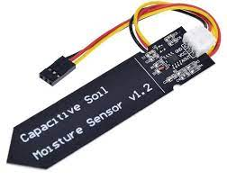
Idea of the project
The development of a smart irrigation system that can automatically sense the water requirements in a farm based on soil moisture measurements, using a soil moisture sensor. A drip irrigation system is activated based on the soil moisture levels so that optimal water is put in the farm to reduce the amount of water wasted due to primitve irrigation technique.

Slide 4
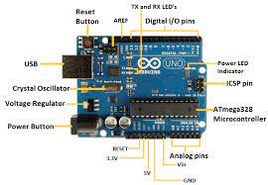
LIST OF HARDWARES AND PINOUTS
The components required are :-
Arduino Uno
Capacitive Soil Moisture Sensor

Slide 5
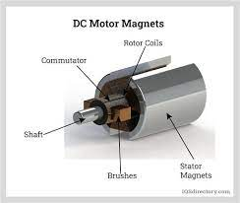
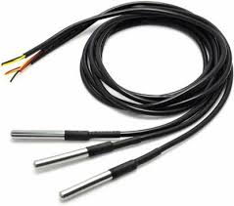
DC Motor
Waterproof DS18B20 Digital temperature sensor

Slide 6
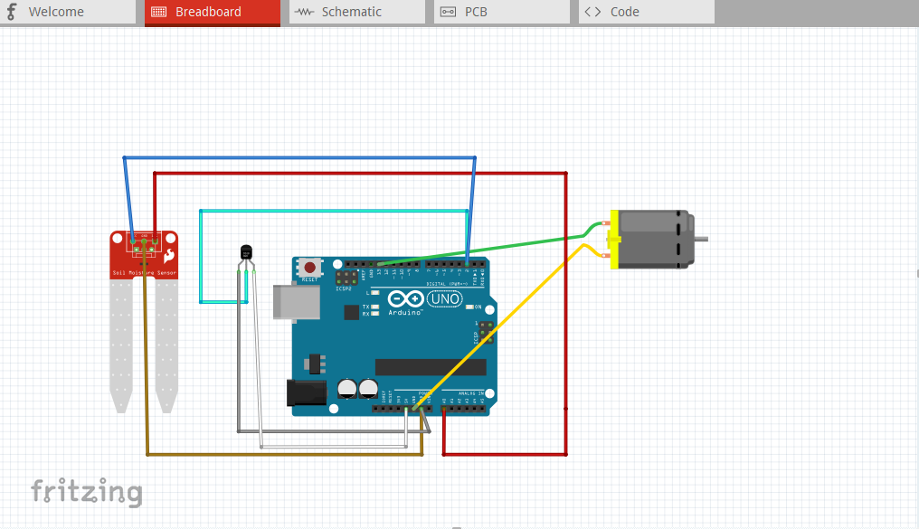
CIRCUIT DIAGRAM

Slide 7
Codes are given the provided folder

